Slide 1


CRYPTOGRAPHY
Symmetric Encryption
Block Cipher

Slide 2
OUTLINE
STREAM CIPHER VS BLOCK CIPHER
FEISTEL STRUCTURE
DATA ENCRYPTION STANDARD (DES)
ADVANCED ENCRYPTION STANDARD (AES)
BLOCK CIPHER MODE OF OPERATION
KEY MANAGEMENT (SYMMETRIC KEY)

Slide 3
Objectives
01
To understand the difference between stream cipher and block cipher
03
04
To know the available block cipher encryption techniques
05
To understand the Feistel structure and design features
To know the implementation of DES and AES
02
To understand the different types of block cipher modes of operation
06
To understand the key management method

Slide 4
INTRODUCTION
01
Terminology
Types

Slide 5
Terminology
Plaintext
The original message
Ciphertext
The coded message
Enciphering or encryption
Process of converting from plaintext to ciphertext
Deciphering or decryption
Restoring the plaintext from the ciphertext

Slide 6
Basic Concept of Cryptography
Encryption algorithms are standardized & published
Cipher
A method to encrypt messages
Key
is an input to the algorithm and must be kept secret
is a string of numbers or characters
Algorithm types
If same key is used for encryption & decryption the algorithm is called symmetric
If different keys are used for encryption & decryption the algorithm is called asymmetric

Slide 7
Cryptographic Systems
Characterized along three independent dimensions:
The type of operations used for transforming plaintext to ciphertext
Substitution
Transposition
The number of keys used
Symmetric, single-key, secret-key, conventional encryption
Asymmetric, two-key, or public-key encryption
The way in which the plaintext is processed
Block cipher
Stream cipher
Notes:
Cryptographic systems are characterized along three independent dimensions:
1. The type of operations used for transforming plaintext to ciphertext. All
encryption algorithms are based on two general principles: substitution, in
which each element in the plaintext (bit, letter, group of bits or letters) is
mapped into another element, and transposition, in which elements in the
plaintext are rearranged. The fundamental requirement is that no information
be lost (i.e., that all operations are reversible). Most systems, referred to as
product systems , involve multiple stages of substitutions and transpositions.
2. The number of keys used. If both sender and receiver use the same key, the
system is referred to as symmetric, single-key, secret-key, or conventional
encryption. If the sender and receiver use different keys, the system is referred
to as asymmetric, two-key, or public-key encryption.
3. The way in which the plaintext is processed. A block cipher processes the
input one block of elements at a time, producing an output block for each
input block. A stream cipher processes the input elements continuously,
producing output one element at a time, as it goes along.

Slide 8
Types of Encryption Techniques
Types of Encryption
Symmetric (Secret key)
Asymmetric (Public key)
Stream Cipher
Block Cipher
Block Cipher
Substitution Technique
Transposition Technique
Feistel Structure
(DES)
Iterative
(AES)

Slide 9
SYMMETRIC
02
Simplified Model

Slide 10
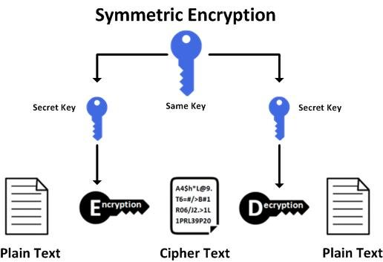
Simplified Model of Symmetric Encryption
Notes:
A symmetric encryption scheme has five ingredients (Figure 2.1):
• Plaintext: This is the original intelligible message or data that is fed into the
algorithm as input.
• Encryption algorithm: The encryption algorithm performs various substitutions
and transformations on the plaintext.
• Secret key: The secret key is also input to the encryption algorithm. The key
is a value independent of the plaintext and of the algorithm. The algorithm
will produce a different output depending on the specific key being used at the
time. The exact substitutions and transformations performed by the algorithm
depend on the key.
• Ciphertext: This is the scrambled message produced as output. It depends on
the plaintext and the secret key. For a given message, two different keys will
produce two different ciphertexts. The ciphertext is an apparently random
stream of data and, as it stands, is unintelligible.
• Decryption algorithm: This is essentially the encryption algorithm run in
reverse. It takes the ciphertext and the secret key and produces the original
plaintext.

Slide 11
Symmetric Encryption Techniques
03
Stream Ciphers
Block Ciphers

Slide 12
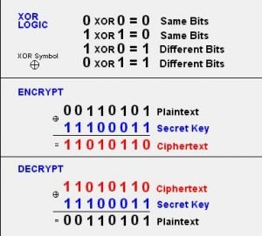
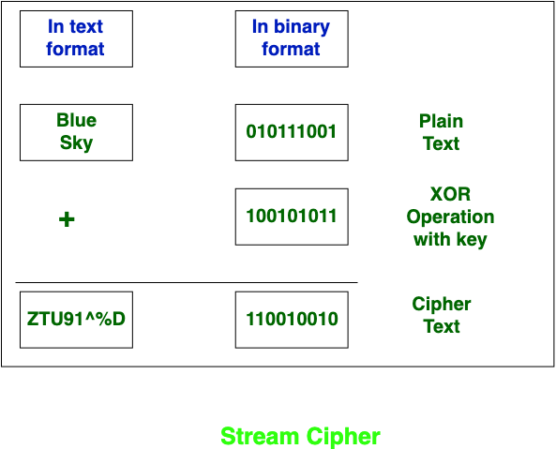
Stream Cipher (recap)
A stream cipher is one that encrypts a digital data stream one bit or one byte at a time.
It must be computationally impractical to predict future portions of the bit stream based on previous portions of the bit stream.
Notes:
A stream cipher is one that encrypts a digital data stream one bit or one byte at
a time.
Examples of classical stream ciphers are the autokeyed Vigenère cipher
and the Vernam cipher. In the ideal case, a one-time pad version of the Vernam
cipher would be used (Figure 2.7), in which the keystream (ki ) is as long as the
plaintext bit stream (pi ). If the cryptographic keystream is random, then this cipher
is unbreakable by any means other than acquiring the keystream. However, the
keystream must be provided to both users in advance via some independent and
secure channel. This introduces insurmountable logistical problems if the intended
data traffic is very large.
Accordingly, for practical reasons, the bit-stream generator must be
implemented as an algorithmic procedure, so that the cryptographic bit stream
can be produced by both users. In this approach (Figure 3.1a), the bit-stream
generator is a key-controlled algorithm and must produce a bit stream that is
cryptographically strong. That is, it must be computationally impractical to
predict future portions of the bit stream based on previous portions of the bit
stream. The two users need only share the generating key, and each can produce
the keystream.

Slide 13
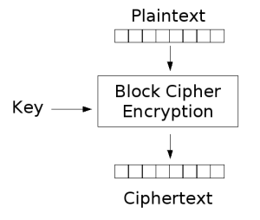

Block Cipher
A block of plaintext is treated as a whole and used to produce a ciphertext block of equal length
Typically a block size of 64 or 128 bits is used
As with a stream cipher, the two users share a symmetric encryption key
The majority of network-based symmetric cryptographic applications make use of block ciphers
Notes:
A block cipher is one in which a block of plaintext is treated as a whole
and used to produce a ciphertext block of equal length.
Typically, a block size of
64 or 128 bits is used. As with a stream cipher, the two users share a symmetric
encryption key.

Slide 14

Block Cipher Modes of Operation
A mode of operation describes how to repeatedly apply a cipher's single-block operation to securely transform amounts of data larger than a block
NIST SP 800-38A: Recommendation for Block Cipher Modes of Operation.
Electronic Codebook (ECB) Mode
Cipher Block Chaining (CBC) Mode
Cipher Feedback (CFB) Mode
Output Feedback (OFB) Mode
Counter (CTR) Mode
Notes:
Far more effort has gone into analyzing block ciphers. In general, they seem
applicable to a broader range of applications than stream ciphers. The vast majority
of network-based symmetric cryptographic applications make use of block
ciphers. Accordingly, the concern in this chapter, and in our discussions throughout
the book of symmetric encryption, will primarily focus on block ciphers.

Slide 15
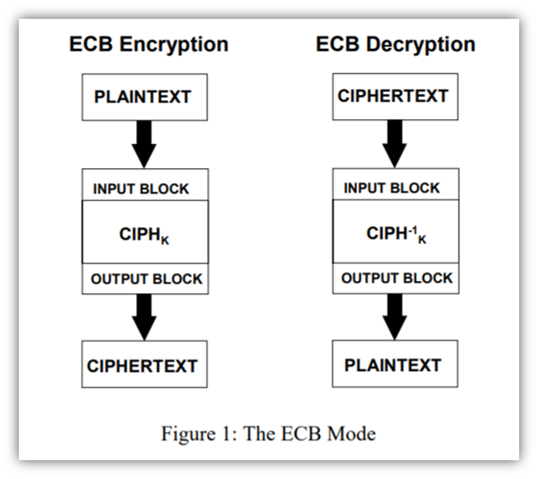
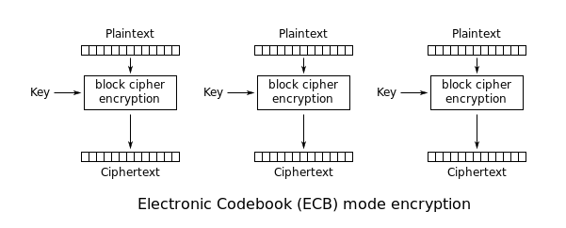
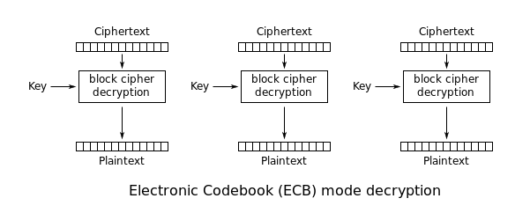
Block Cipher Modes of Operation
Electronic Codebook (ECB) Mode
Notes:
The simplest of the encryption modes is the electronic codebook (ECB) mode (named after conventional physical codebooks^{[19]}). The message is divided into blocks, and each block is encrypted separately.
The disadvantage of this method is a lack of diffusion. Because ECB encrypts identical plaintext blocks into identical ciphertext blocks, it does not hide data patterns well. ECB is not recommended for use in cryptographic protocols
Electronic Codebook (ECB) Mode
Description:
ECB is the simplest mode of operation for block ciphers.
It encrypts each block of data independently.
Each block of plaintext is encrypted with the same key to produce a block of ciphertext.
Advantages:
Simple and fast.
Parallel processing of blocks is possible.
Disadvantages:
Identical plaintext blocks result in identical ciphertext blocks, making patterns visible and compromising security.
Not suitable for encrypting large data sets.
Applications:
Suitable for small amounts of data where patterns are not an issue, such as encrypting a small number of fixed-length fields in a database.

Slide 16
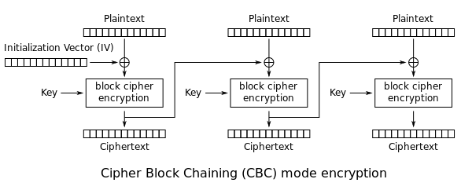
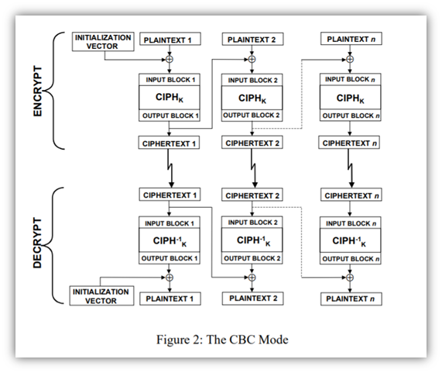
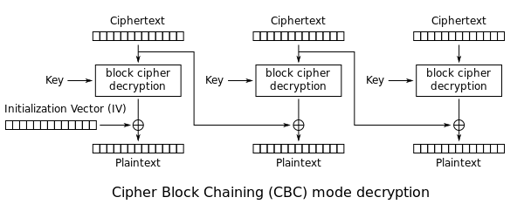
Block Cipher Modes of Operation
Cipher Block Chaining (CBC) Mode
Notes:
Ehrsam, Meyer, Smith and Tuchman invented the cipher block chaining (CBC) mode of operation in 1976.[23] In CBC mode, each block of plaintext is XORed with the previous ciphertext block before being encrypted. This way, each ciphertext block depends on all plaintext blocks processed up to that point. To make each message unique, an initialization vector must be used in the first block
The top section, from left to right, shows how three separate messages are chained together and encrypted. The bottom section, from left to right, shows how those separate messages are decrypted.So, basically, CBC mode takes ECB mode and kicks it up a notch in terms of complexity and confidentiality by adding data from previous bocks. However, it’s not used all that often anymore. Why? A couple of important reasons:
This operation mode is slow. You can’t encrypt or decrypt two or more messages simultaneously because each message includes data from the previous block. While this may not be an issue for small files, it can prove a big challenge for encryption or decryption at scale.
This mode of operation is susceptible to padding attacks and manipulation. If an attacker manages to alter the ciphertext of one block, the next block would be affected because of the data chaining.
Explanation:
In CBC mode, each block of plaintext is XORed with the previous ciphertext block before being encrypted.
An initialization vector (IV) is used for the first block to ensure uniqueness.
Advantages:
Identical plaintext blocks result in different ciphertext blocks due to chaining.
More secure than ECB for large data sets.
Disadvantages:
Encryption cannot be parallelized, though decryption can be.
Requires an IV, which must be unique and random for each encryption session.
Applications:
Commonly used in file encryption and secure data transmission where data integrity is important.

Slide 17
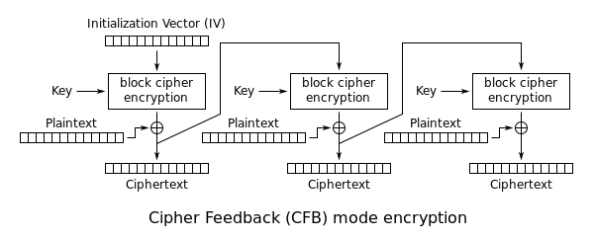
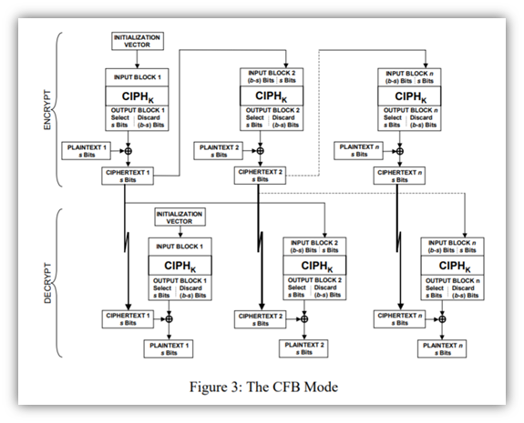
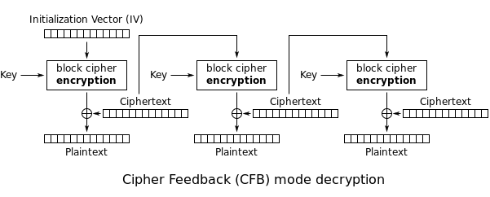
Block Cipher Modes of Operation
Cipher Feedback (CFB) Mode
Notes:
The cipher feedback (CFB) mode, in its simplest form uses the entire output of the block cipher. In this variation, it is very similar to CBC, makes a block cipher into a self-synchronizing stream cipher. CFB decryption in this variation is almost identical to CBC encryption performed in reverse:
This operational mode generates pseudorandom bits. It uses the ciphertext from the previous block in the chain (this is known as feedback, hence the fitting name) and a cryptographic key to do this.
An important point to note is that an encryption cipher function is used in both the encryption and decryption processes, rather than using an encryption function for the first and decryption function for the latter. Also, error propagation is an issue with CFB mode because an error in one block can carry over into the next (although it wouldn’t affect the block beyond that).

Slide 18
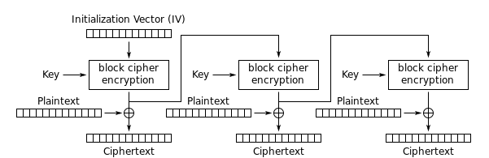
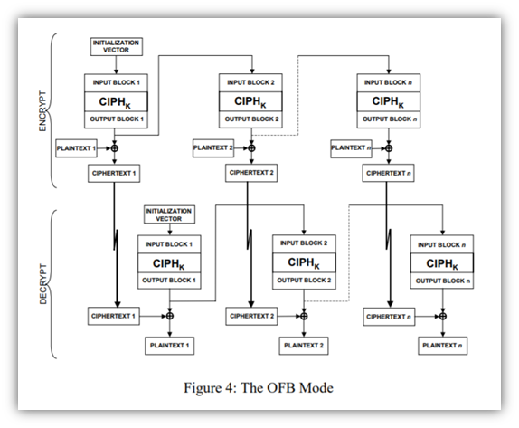
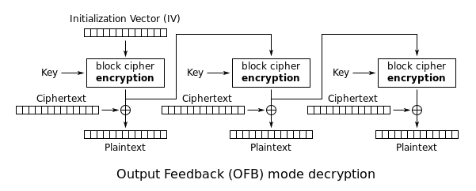
Block Cipher Modes of Operation
Output Feedback (OFB) Mode
Notes:
The output feedback (OFB) mode makes a block cipher into a synchronous stream cipher. It generates keystream blocks, which are then XORed with the plaintext blocks to get the ciphertext. Just as with other stream ciphers, flipping a bit in the ciphertext produces a flipped bit in the plaintext at the same location. This property allows many error-correcting codes to function normally even when applied before encryption.
Explanation:
OFB also turns a block cipher into a stream cipher.
It generates keystream blocks, which are then XORed with plaintext blocks to produce ciphertext blocks.
Advantages:
Errors do not propagate, meaning a bit error in ciphertext only affects the corresponding bit in plaintext.
Encryption and decryption can be parallelized.
Disadvantages:
Requires an IV.
If the same IV is reused, it compromises security.
Applications:
Useful for encrypting data streams where error propagation is a concern, like in satellite communications.

Slide 19
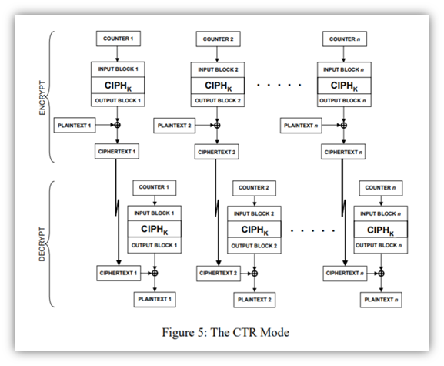
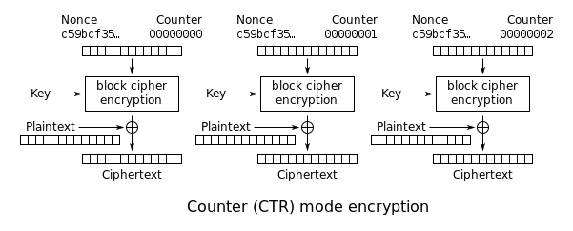
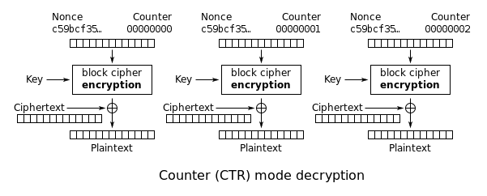
Block Cipher Modes of Operation
Counter (CTR) Mode
Notes:
Like OFB, counter mode turns a block cipher into a stream cipher. It generates the next keystream block by encrypting successive values of a "counter". The counter can be any function which produces a sequence which is guaranteed not to repeat for a long time, although an actual increment-by-one counter is the simplest and most popular. today CTR mode is widely accepted and any problems are considered a weakness of the underlying block cipher, which is expected to be secure regardless of systemic bias in its input. Along with CBC, CTR mode is one of two block cipher modes recommended by Niels Ferguson and Bruce Schneier.
This operational mode, the newest one recommended by NIST, is designed to serve as a counter for pseudorandom generation (hence the name). This is one of the most commonly used modes of operation.
CTR mode has similarities to OFB mode but is still different. For example, unlike the previous operational modes, CTR doesn’t require explicit chaining and is parallelizable. This means that you can process and encrypt separate messages in parallel (like stream ciphers). So, this means that because it doesn’t depend on the output from a previous block, you can decrypt two blocks independently.
The security of this mode depends on the protection of the counter values (CVs), so you should never recycle your CVs.
Counter (CTR) Mode
Explanation:
CTR mode turns a block cipher into a stream cipher by using a counter that increments for each block.
The counter is encrypted and then XORed with the plaintext to produce the ciphertext.
Advantages:
High performance: encryption and decryption can be parallelized.
No error propagation.
Disadvantages:
Requires a unique counter for each encryption session to ensure security.
Managing counters can be complex.
Applications:
Commonly used in high-performance applications such as disk encryption and network encryption protocols.

Slide 20
Block Cipher Modes of Operation
Mode | Strengths | Weaknesses | Application
ECB | - Simple and easy to implement. | - Identical plaintext blocks result in identical ciphertext blocks. | - Legacy encryption systems. - Disk encryption for individual files. (limited use due to its weakness)
CBC | - Provides confidentiality and integrity. | - Slower than ECB due to dependency on previous ciphertext blocks (sequential processing). | - Secure communication protocols (e.g., TLS). - Full-disk encryption (e.g., BitLocker, FileVault). - VPN connections.
CFB | - Real-time encryption for streaming data. | - Sensitive to bit errors, as an error affects subsequent blocks. | - Secure voice communication systems. - Disk encryption for virtual machines.
OFB | - Self-synchronizing and parallelizable. | - Error propagation; a single error doesn't disrupt decryption, but subsequent blocks can be affected. | - Secure data transmission in unreliable channels. - Secure remote access systems.
CTR | - High-speed encryption and parallel processing. | - No integrity protection (encryption only). -Requires a unique nonce/counter for each message to maintain security | - Full-disk encryption for SSDs. - Secure communication protocols. - Network encryption

Slide 21
Symmetric Encryption Technique
04
Feistel Structure / Cipher

Slide 22
What is a Feistel Cipher?
Feistel cipher is a symmetric structure used in the design of many block ciphers.
Named after Horst Feistel, a German-American cryptographer.
Purpose:
To securely transform plaintext into ciphertext using a series of repetitive steps and round functions.
Notes:
Feistel proposed [FEIS73] that we can approximate the ideal block cipher by utilizing
the concept of a product cipher, which is the execution of two or more simple ciphers
in sequence in such a way that the final result or product is cryptographically stronger
than any of the component ciphers. The essence of the approach is to develop a block
cipher with a key length of k bits and a block length of n bits, allowing a total of 2^{k}
possible transformations, rather than the 2^{n} ! transformations available with the ideal
block cipher.
In particular, Feistel proposed the use of a cipher that alternates substitutions
and permutations, where these terms are defined as follows:
• Substitution: Each plaintext element or group of elements is uniquely replaced
by a corresponding ciphertext element or group of elements.
• Permutation: A sequence of plaintext elements is replaced by a permutation
of that sequence. That is, no elements are added or deleted or replaced in the
sequence, rather the order in which the elements appear in the sequence is
changed.
In fact, Feistel’s is a practical application of a proposal by Claude Shannon
to develop a product cipher that alternates confusion and diffusion functions
[SHAN49]. We look next at these concepts of diffusion and confusion and then
present the Feistel cipher. But first, it is worth commenting on this remarkable fact:
The Feistel cipher structure, which dates back over a quarter century and which, in
turn, is based on Shannon’s proposal of 1945, is the structure used by many significant
symmetric block ciphers currently in use.

Slide 23
Feistel Cipher - Introduction
Proposed the use of a cipher that alternates substitutions and permutations
Is the structure used by many significant symmetric block ciphers currently in use
Substitutions
Each plaintext element or group of elements is uniquely replaced by a corresponding ciphertext element or group of elements
Permutation/ Transposition
No elements are added or deleted or replaced in the sequence, rather the order in which the elements appear in the sequence is changed
Notes:
Feistel proposed [FEIS73] that we can approximate the ideal block cipher by utilizing
the concept of a product cipher, which is the execution of two or more simple ciphers
in sequence in such a way that the final result or product is cryptographically stronger
than any of the component ciphers. The essence of the approach is to develop a block
cipher with a key length of k bits and a block length of n bits, allowing a total of 2^{k}
possible transformations, rather than the 2^{n} ! transformations available with the ideal
block cipher.
In particular, Feistel proposed the use of a cipher that alternates substitutions
and permutations, where these terms are defined as follows:
• Substitution: Each plaintext element or group of elements is uniquely replaced
by a corresponding ciphertext element or group of elements.
• Permutation: A sequence of plaintext elements is replaced by a permutation
of that sequence. That is, no elements are added or deleted or replaced in the
sequence, rather the order in which the elements appear in the sequence is
changed.
In fact, Feistel’s is a practical application of a proposal by Claude Shannon
to develop a product cipher that alternates confusion and diffusion functions
[SHAN49]. We look next at these concepts of diffusion and confusion and then
present the Feistel cipher. But first, it is worth commenting on this remarkable fact:
The Feistel cipher structure, which dates back over a quarter century and which, in
turn, is based on Shannon’s proposal of 1945, is the structure used by many significant
symmetric block ciphers currently in use.

Slide 24
Feistel Cipher - Introduction
Round Functions
A round function is a set of operations applied repeatedly to data and a round key during each round of the encryption process to progressively transform plaintext into ciphertext.
Notes:
Feistel proposed [FEIS73] that we can approximate the ideal block cipher by utilizing
the concept of a product cipher, which is the execution of two or more simple ciphers
in sequence in such a way that the final result or product is cryptographically stronger
than any of the component ciphers. The essence of the approach is to develop a block
cipher with a key length of k bits and a block length of n bits, allowing a total of 2^{k}
possible transformations, rather than the 2^{n} ! transformations available with the ideal
block cipher.
In particular, Feistel proposed the use of a cipher that alternates substitutions
and permutations, where these terms are defined as follows:
• Substitution: Each plaintext element or group of elements is uniquely replaced
by a corresponding ciphertext element or group of elements.
• Permutation: A sequence of plaintext elements is replaced by a permutation
of that sequence. That is, no elements are added or deleted or replaced in the
sequence, rather the order in which the elements appear in the sequence is
changed.
In fact, Feistel’s is a practical application of a proposal by Claude Shannon
to develop a product cipher that alternates confusion and diffusion functions
[SHAN49]. We look next at these concepts of diffusion and confusion and then
present the Feistel cipher. But first, it is worth commenting on this remarkable fact:
The Feistel cipher structure, which dates back over a quarter century and which, in
turn, is based on Shannon’s proposal of 1945, is the structure used by many significant
symmetric block ciphers currently in use.

Slide 25
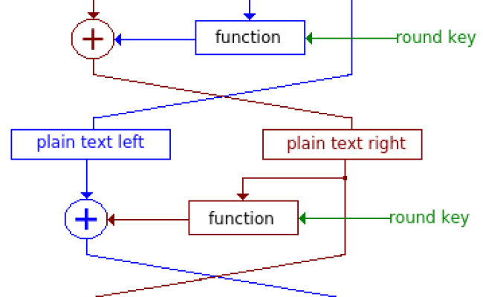
Feistel Cipher – Steps
Steps:
Divide Plaintext:
Split plaintext block into two equal halves: L0 and R0.
Round Function:
Apply a round function (F) to one half and XOR the result with the other half.
Swap:
Swap the halves.
Repeat:
Perform multiple rounds (iterations) of the process.
Notes:
The left-hand side of Figure 3.3 depicts the structure
proposed by Feistel.
The inputs to the encryption algorithm are a plaintext block of
length 2w bits and a key K .
The plaintext block is divided into two halves, L₀ and R₀ .
The two halves of the data pass through n rounds of processing and then combine to
produce the ciphertext block. Each round i has as inputs L_{i-1} and R_{i-1} derived from
the previous round, as well as a subkey K_{i} derived from the overall K . In general,
the subkeys K_{i} are different from K and from each other.
In Figure 3.3, 16 rounds
are used, although any number of rounds could be implemented.
All rounds have the same structure.
A substitution is performed on the left half
of the data. This is done by applying a round function F to the right half of the data
and then taking the exclusive-OR of the output of that function and the left half of the
data. The round function has the same general structure for each round but is parameterized
by the round subkey K_{i} . Another way to express this is to say that F is a function
of right-half block of w bits and a subkey of y bits, which produces an output value
of length w bits: F (RE_{i} , K_{i+1} ).
Following this substitution, a permutation is performed
that consists of the interchange of the two halves of the data.
This structure is a particular
form of the substitution-permutation network (SPN) proposed by Shannon.

Slide 26
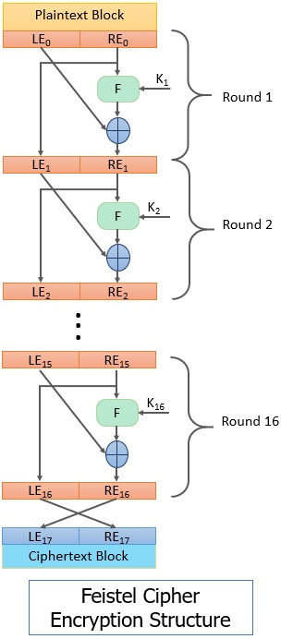
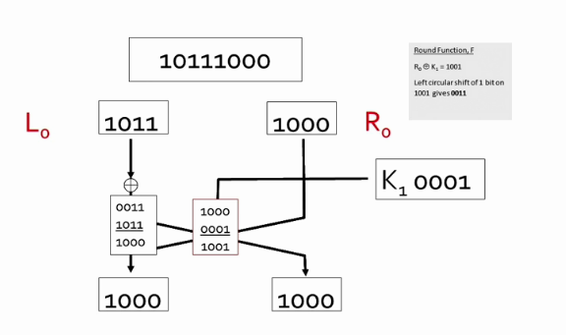
LEx= Left half
Left half of the plaintext block
REx = Right half
Right half of the plaintext block
Kx = Round Key
F = Round Function
Perform substitution and permutation
Fx = XOR (REx, Kx)
= XOR
Notes:
Substitution
A substitution is performed on the left half
of the data. This is done by applying a round function F to the right half of the data
and then taking the exclusive-OR of the output of that function and the left half of the
data. The round function has the same general structure for each round but is parameterized
by the round subkey Ki . Another way to express this is to say that F is a function
of right-half block of w bits and a subkey of y bits, which produces an output value
of length w bits: F (REi , Ki+1 ).

Slide 27
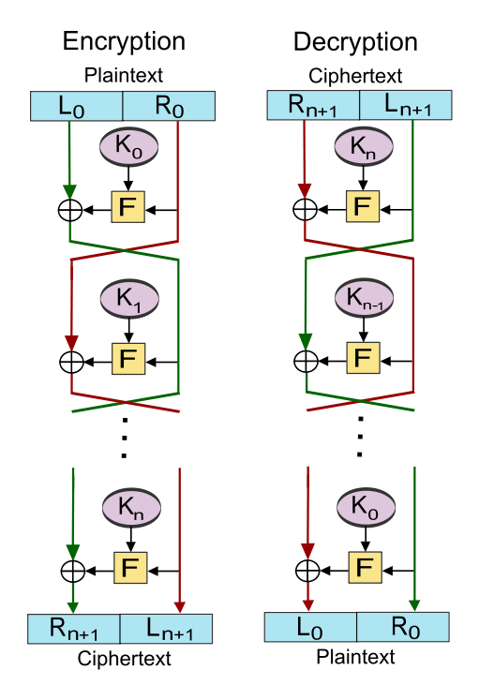
Feistel Cipher – Decryption
The decryption algorithm is exactly the same as the encryption algorithm with the only difference that the round keys are used in the reverse order.
The output of each round during decryption is the input to the corresponding round during encryption except for the left-right switch between the two halves.

Slide 28
Feistel Cipher - Design Features
Block size
Larger block sizes mean greater security but reduced encryption/decryption speed for a given algorithm
Key size
Larger key size means greater security but may decrease encryption/decryption speeds
Number of rounds
The essence of the Feistel cipher is that a single round offers inadequate security but that multiple rounds offer increasing security
Subkey generation algorithm
Greater complexity in this algorithm should lead to greater difficulty of cryptanalysis
Round function F
Greater complexity generally means greater resistance to cryptanalysis
Notes:
The exact realization of a Feistel network depends on the choice of the following
parameters and design features:
• Block size: Larger block sizes mean greater security (all other things being
equal) but reduced encryption/decryption speed for a given algorithm. The
greater security is achieved by greater diffusion. Traditionally, a block size of
64 bits has been considered a reasonable tradeoff and was nearly universal in
block cipher design. However, the new AES uses a 128-bit block size.
• Key size: Larger key size means greater security but may decrease encryption/
decryption speed. The greater security is achieved by greater resistance to
brute-force attacks and greater confusion. Key sizes of 64 bits or less are now
widely considered to be inadequate, and 128 bits has become a common size.
• Number of rounds: The essence of the Feistel cipher is that a single round
offers inadequate security but that multiple rounds offer increasing security.
A typical size is 16 rounds.
• Subkey generation algorithm: Greater complexity in this algorithm should
lead to greater difficulty of cryptanalysis.
• Round function F: Again, greater complexity generally means greater resistance
to cryptanalysis.
There are two other considerations in the design of a Feistel cipher:
• Fast software encryption/decryption: In many cases, encryption is embedded in
applications or utility functions in such a way as to preclude a hardware implementation.
Accordingly, the speed of execution of the algorithm becomes a
concern.
• Ease of analysis: Although we would like to make our algorithm as difficult as
possible to cryptanalyze, there is great benefit in making the algorithm easy to
analyze. That is, if the algorithm can be concisely and clearly explained, it is
easier to analyze that algorithm for cryptanalytic vulnerabilities and therefore
develop a higher level of assurance as to its strength. DES, for example, does
not have an easily analyzed functionality.

Slide 29

Quiz 1
List all design features proposed by Feistel cipher/structure.

Slide 30
Symmetric Encryption Algorithm
05
Data Encryption Standard (DES)

Slide 31
Block Cipher
Data Encryption Standard (DES)
Triple DES
Advanced Encryption Standard (AES)
Twofish
IDEA
Serpent
Major symmetric block cipher algorithms / schemes

Slide 32

Data Encryption Standard (DES)
Issued in 1977 by the National Bureau of Standards (now NIST) as Federal Information Processing Standard 46
Was the most widely used encryption scheme until the introduction of the Advanced Encryption Standard (AES) in 2001
Algorithm itself is referred to as the Data Encryption Algorithm (DEA)
Based on Feistel Cipher / Structure
Data are encrypted in 64-bit blocks
The algorithm transforms 64-bit input in a series of steps into a 64-bit output
The same steps, with the same key, are used to reverse the encryption
Notes:
Until the introduction of the Advanced Encryption Standard (AES) in 2001, the
Data Encryption Standard (DES) was the most widely used encryption scheme.
DES was issued in 1977 by the National Bureau of Standards, now the National
Institute of Standards and Technology (NIST), as Federal Information Processing
Standard 46 (FIPS PUB 46). The algorithm itself is referred to as the Data
Encryption Algorithm (DEA). For DEA, data are encrypted in 64-bit blocks using
a 56-bit key. The algorithm transforms 64-bit input in a series of steps into a 64-bit
output. The same steps, with the same key, are used to reverse the encryption.
Over the years, DES became the dominant symmetric encryption algorithm,
especially in financial applications. In 1994, NIST reaffirmed DES for federal use
for another five years; NIST recommended the use of DES for applications other
than the protection of classified information. In 1999, NIST issued a new version
of its standard (FIPS PUB 46-3) that indicated that DES should be used only for
legacy systems and that triple DES (which in essence involves repeating the DES
algorithm three times on the plaintext using two or three different keys to produce
the ciphertext) be used. We study triple DES in Chapter 6. Because the underlying
encryption and decryption algorithms are the same for DES and triple DES, it
remains important to understand the DES cipher. This section provides an overview.
For the interested reader, Appendix S provides further detail.

Slide 33
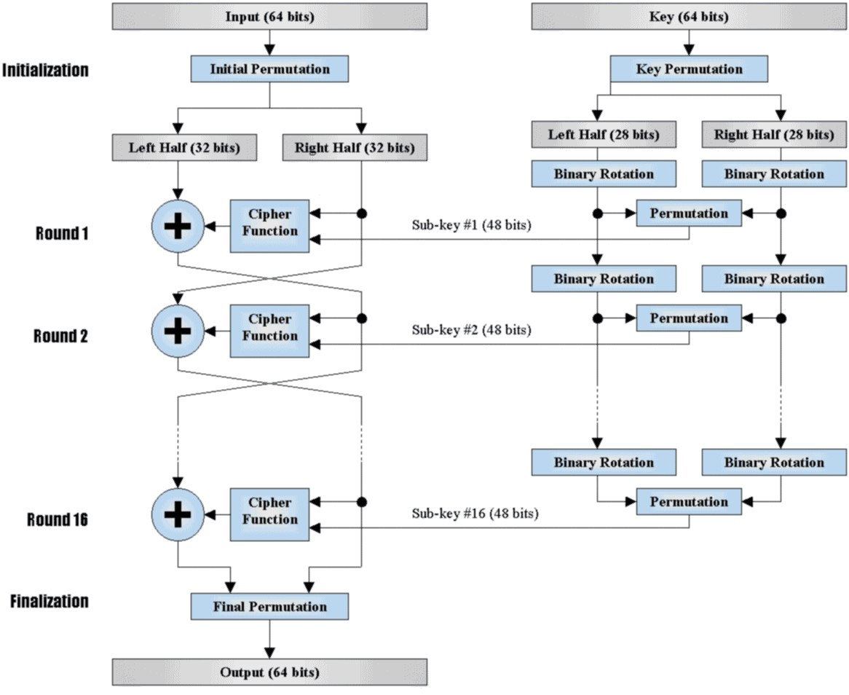
DES Two main operations 1) Key Generation 2) Encryption
ENCRYPTION
KEY GENERATION
Block Size = 64 bits
Key Size = 64 bits
SubKey Size = 48 bits
No of Subkeys = 16
No of Rounds = 16
Cipher text size = 64 bits

Slide 34
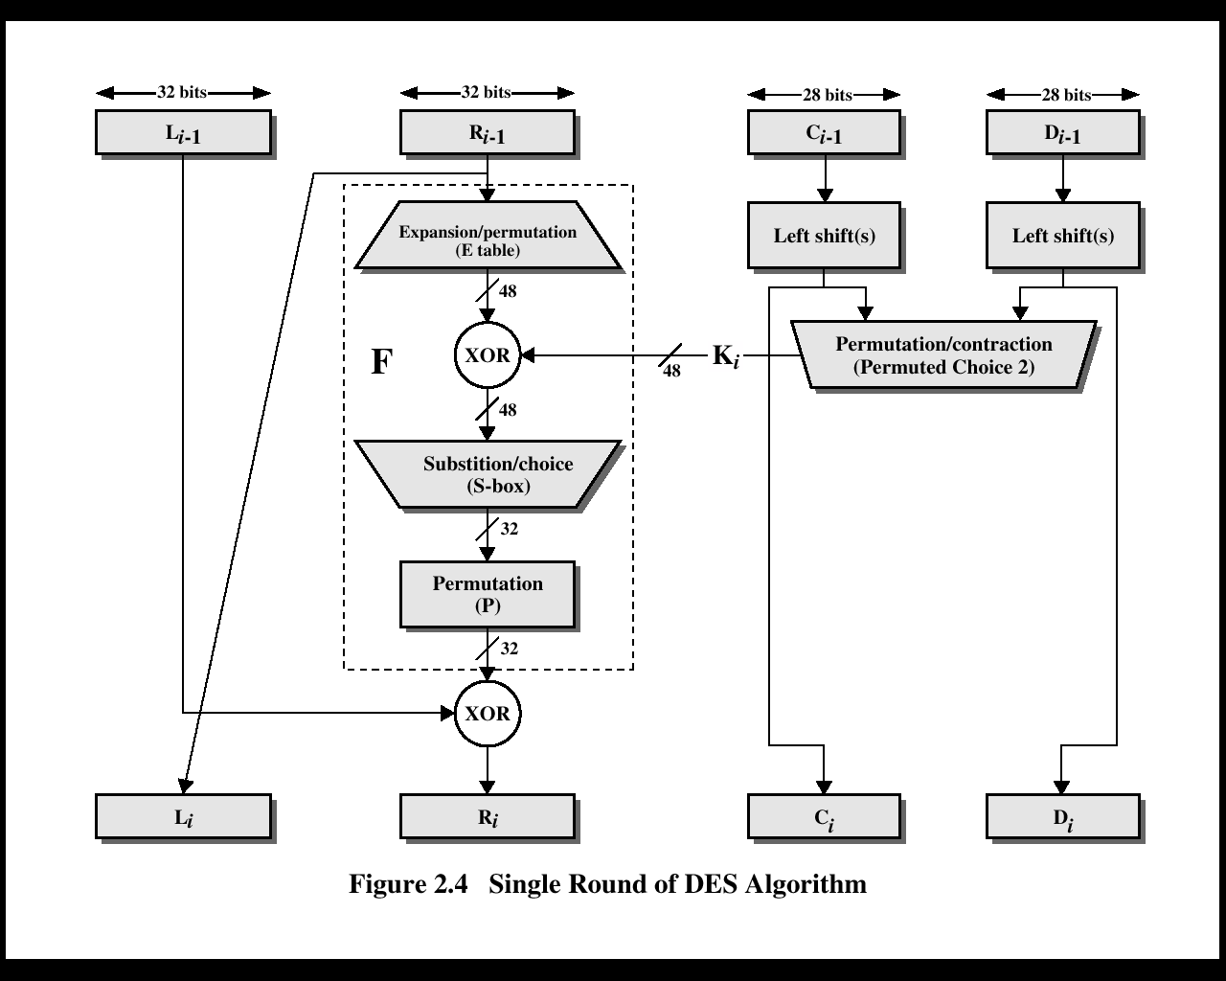
DES Single Round Operation of DES Algorithm
ENCRYPTION
KEY GENERATION
Block Size = 64 bits
Key Size = 64 bits
SubKey Size = 48 bits
No of Subkeys = 16
No of Rounds = 16
Cipher text size = 64 bits
Notes:
The overall scheme for DES encryption is illustrated in Figure 3.5. As with any encryption scheme, there are two Looking at the left-hand side of the figure, we can see that the processing of the plaintext proceeds in three phases. First, the 64-bit plaintext passes through an initial permutation (IP) that rearranges the bits to produce the permuted input . This is followed by a phase consisting of sixteen rounds of the same function, which involves both permutation and substitution functions. The output of the last (sixteenth) round consists of 64 bits that are a function of the input plaintext and the key. The left and right halves of the output are swapped to produce the preoutput . Finally, the preoutput is passed through a permutation [IP ⁻¹ ] that is the inverse of the initial permutation function, to produce the 64-bit ciphertext. With the exception of the initial and final permutations, DES has the exact structure of a Feistel cipher, as shown in Figure 3.3. The right-hand portion of Figure 3.5 shows the way in which the 56-bit key is used. Initially, the key is passed through a permutation function. Then, for each of the sixteen rounds, a subkey (K_{i} ) is produced by the combination of a left circular shift and a permutation. The permutation function is the same for each round, but a different subkey is produced because of the repeated shifts of the key bits. As with any Feistel cipher, decryption uses the same algorithm as encryption, except that the application of the subkeys is reversed. Additionally, the initial and final permutations are reversed.

Slide 35
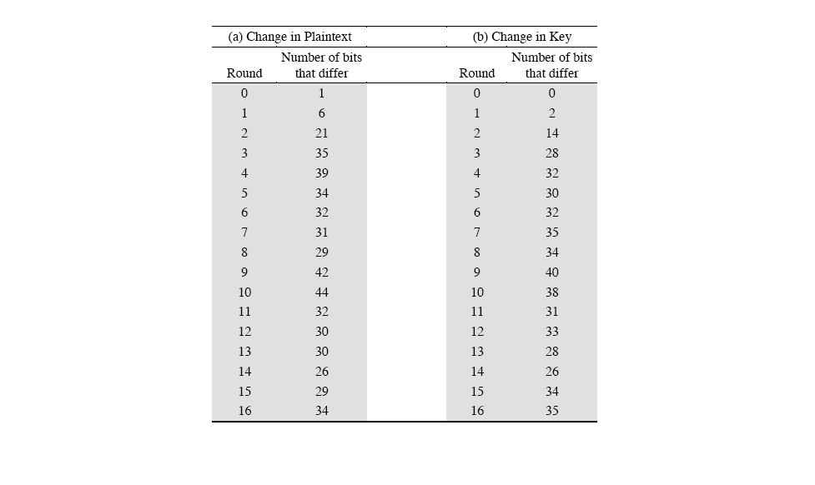
Strength of DES
Avalanche effect in DES
If a small change in either the plaintext or the key, the ciphertext should change markedly / significantly.
DES exhibits a strong avalanche effect.

Slide 36
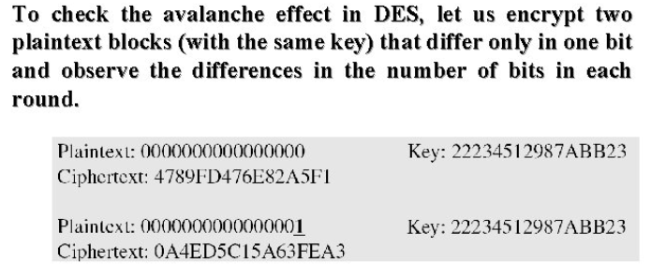
Strength of DES
Avalanche effect in DES

Slide 37
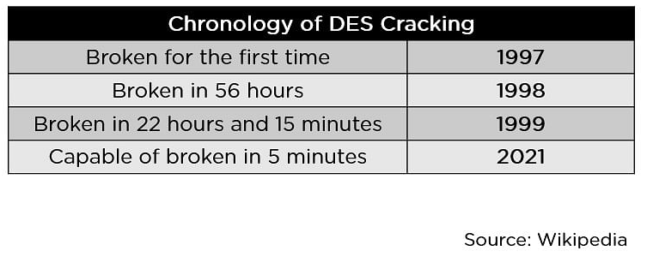
DES Limitations
DES was proved insecure
Brute-force attack
Main weakness : The length of keys (Key Size)

Slide 38
Quiz 2
What is the block size of DES?
What is the length of key (Key size) of DES?
How many rounds in DES?
What is the main weakness of DES?

Slide 39
Symmetric Encryption Algorithm
06
Advanced Encryption Standard (AES)

Slide 40
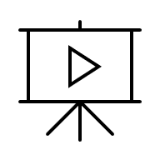
The AES Cipher - Rijndael
designed by Rijmen-Daemen in Belgium
has 128/192/256 bit keys, 128 bit data
an iterative rather than Feistel cipher
processes data as block of 4 columns of 4 bytes
operates on entire data block in every round
Strength
resistance against known attacks
speed and code compactness on many CPUs
design simplicity
Notes:
40
The Rijndael proposal for AES defined a cipher in which the block length and the key length can be independently specified to be 128,192,or 256 bits. The AES specification uses the same three key size alternatives but limits the block length to 128 bits. Rijndael is an academic submission, based on the earlier Square cipher, from Belgium academics Dr Joan Daemen and Dr Vincent Rijmen. It is an iterative cipher (operates on entire data block in every round) rather than feistel (operate on halves at a time), and was designed to have characteristics of: Resistance against all known attacks, Speed and code compactness on a wide range of platforms, & Design simplicity.

Slide 41
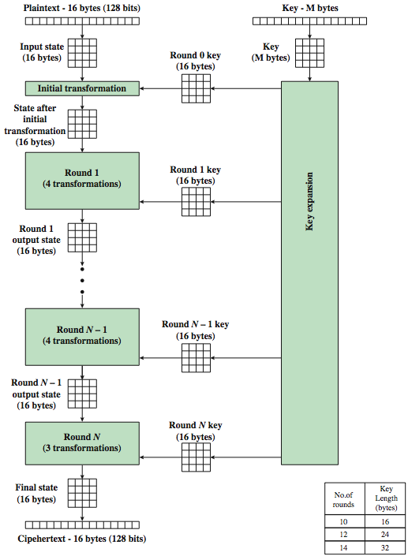
AES
Encryption Process
Plain Text Block Size = 128 Bits
Cipher Text Block Size = 128 Bits
No of Rounds depends on the Key Length
No of Rounds | Key Length
10 | 16 Byte (128 bits)
12 | 24 Byte (192 Bits)
14 | 32 Byte (256 Bits)
Notes:
41
Stallings Figure 5.1 shows the overall encryption process in AES.

Slide 42
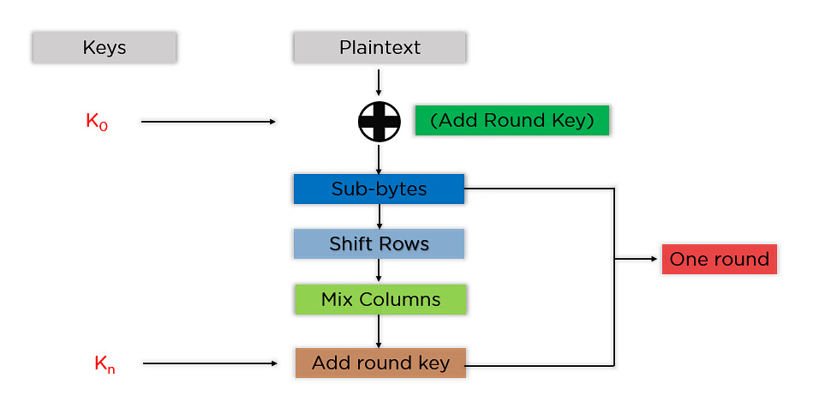
AES – Steps

Slide 43
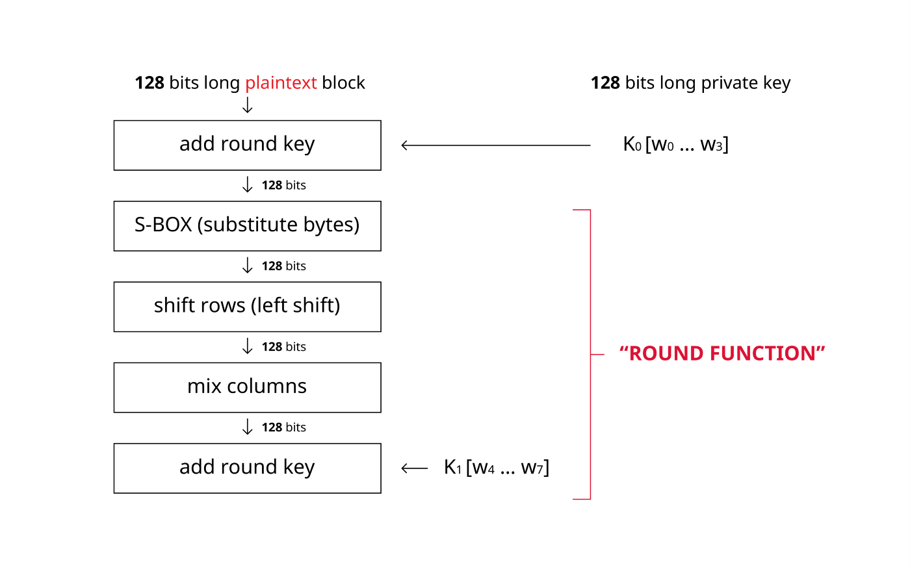
AES – Algorithm

Slide 44
AES – Algorithm
KeyExpansion – round keys are derived from the cipher key using the AES key schedule. AES requires a separate 128-bit round key block for each round plus one more.
Initial round key addition:
AddRoundKey – each byte of the state matrix is combined with a byte of the round key using bitwise xor.
9, 11 or 13 rounds (Round Functions):
SubBytes – a non-linear substitution step where each byte is replaced with another according to a lookup table.
ShiftRows – a transposition step where the last three rows of the state are shifted cyclically a certain number of steps.
MixColumns – a linear mixing operation which operates on the columns of the state, combining the four bytes in each column.
AddRoundKey
Final round (making 10, 12 or 14 rounds in total):
SubBytes
ShiftRows
AddRoundKey

Slide 45
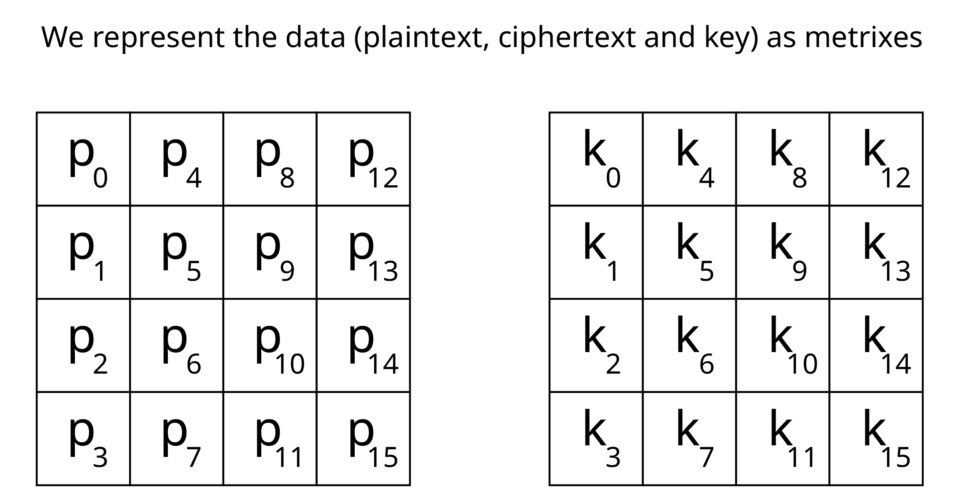
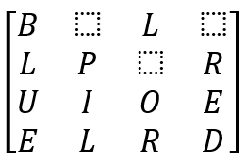
AES - Data Structure
Each Box in the block (state matrix)
= 1 byte
= 8 bits
= 10100000 (example)
Example
= 1 Letter / Box/Cell

Slide 46
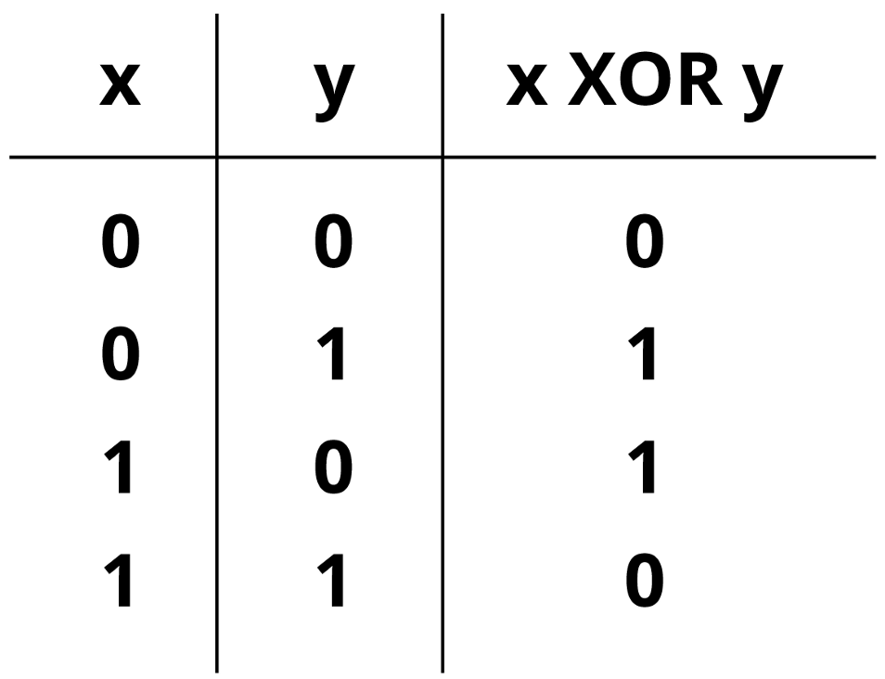
AES : Initial Round
1. Add round key
Perform bitwise XOR operation.
128-bit length plaintext (x)
and 128-bit length key (y)
XOR operate bit by bit.

Slide 47
AES : Round Functions
A. SubBytes – a non-linear substitution step where each byte is replaced with another according to a lookup table.
B. ShiftRows – a transposition step where the last three rows of the state are shifted cyclically a certain number of steps.
C. MixColumns – a linear mixing operation which operates on the columns of the state, combining the four bytes in each column.
D. AddRoundKey

Slide 48
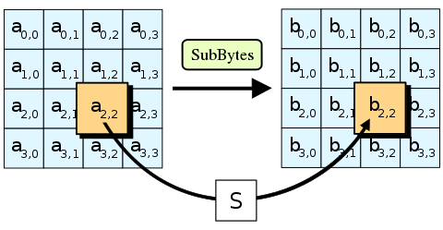
AES : Round Functions
A. The SubBytes step
A nonlinear substitution step where each byte in the state matrix is replaced with a corresponding byte from a fixed substitution table (S-box)

Slide 49
AES : Round Functions - A. The SubBytes step
S_{1,1 =} 45
X = Left 4 bits = 4
Y = Right 4 bits = 5

Slide 50
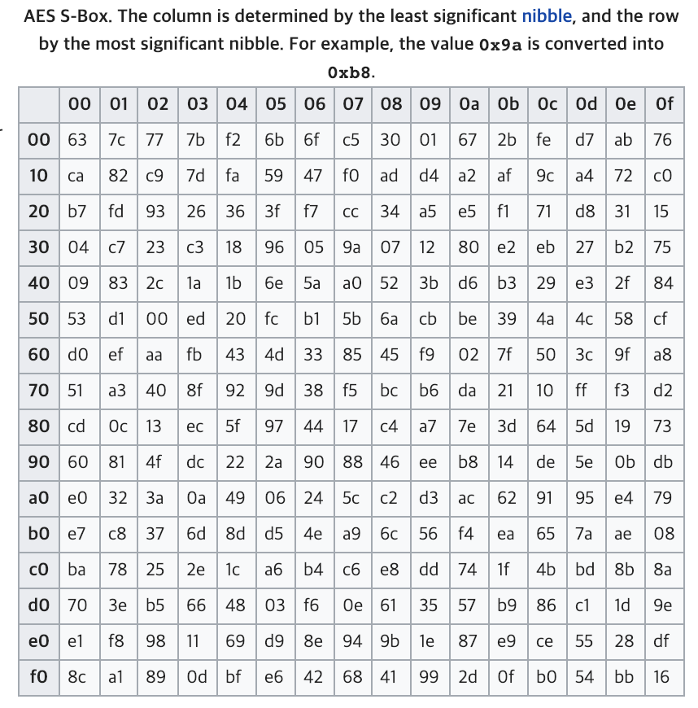
AES : Round Functions - A. The SubBytes step
Input
S_{1,1 =} 45
S_{1,1 =} 0100 0101
4 = 0100
5 = 0101
Output
T_{1,1 =} 6e
X = Left 4 bits (ROW) = 4
Y = Right 4 bits (COLUMN)= 5

Slide 51
AES : Round Functions - B. ShiftRows
B. ShiftRows
A transposition step where the last three rows of the state are shifted cyclically a certain number of steps.
1st row
is unchanged
2nd row
does 1 byte circular shift to left
3rd row
does 2 byte circular shift to left
4th row
does 3 byte circular shift to left

Slide 52
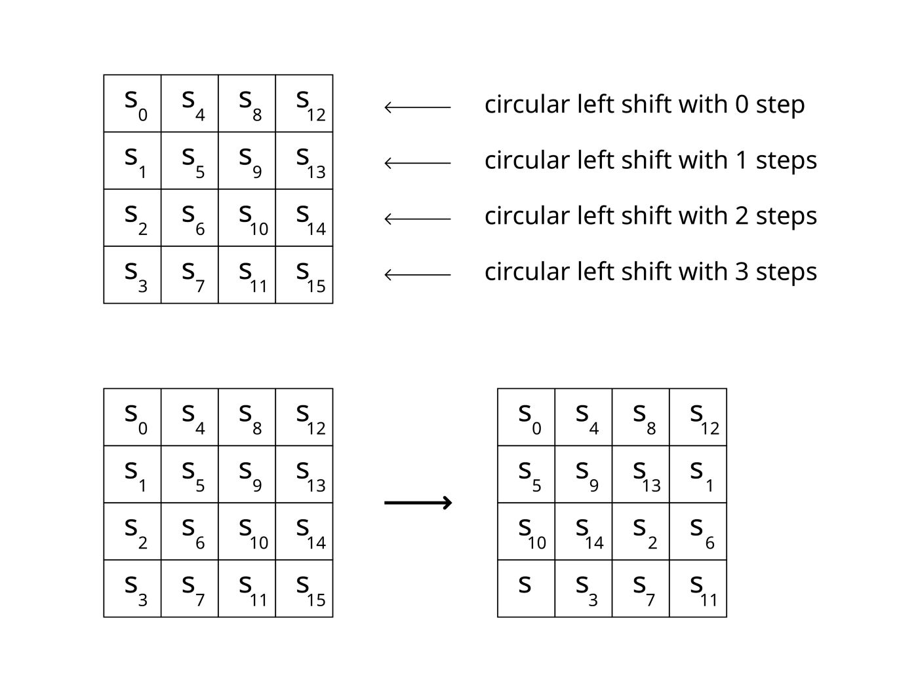
AES : Round Functions - B. ShiftRows
Example

Slide 53
AES : Round Functions - C. MixColumns Step
C. MixColumns Step
A linear mixing operation which operates on the columns of the state, combining the four bytes in each column.
Perform matrix-vector multiplication column by column. Take one column than multiply it to predefined circulant MD5 matrix.
Mix columns step is not executed in last round.

Slide 54
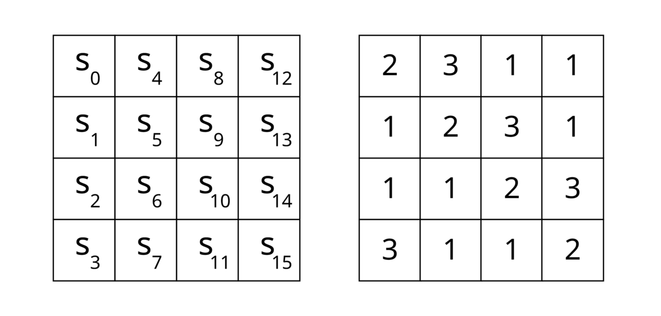
AES : Round Functions - C. MixColumns Step
circulant MD5 matrix

Slide 55
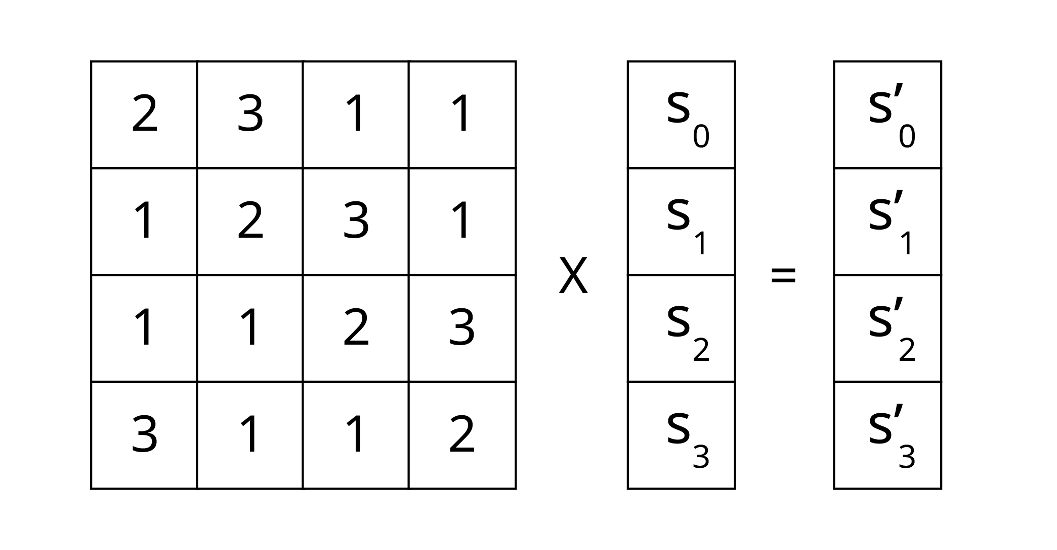
AES : Round Functions - C. MixColumns Step
circulant MD5 matrix
matrix-vector multiplication column by column

Slide 56
AES : Round Functions - C. MixColumns Step
Example

Slide 57
AES : Round Functions - D. AddRoundKey
D. AddRoundKey
XOR Bitwise operation
Use generated round subkey

Slide 58
AES : Round Functions - D. AddRoundKey
Example

Slide 59
Usages of AES
Essentially, AES is a fast and highly secure form of encryption that is a favorite of businesses and governments worldwide.
AES is often included in commercial based products, including but limited to:
Wi-fi
Used as part of WPA2
Libraries in Software Development Languages
Java
C++
Communication Apps
WhatsApp
Facebook Messenger
Games
Grant theft auto
Disk/Partition Encryption
BitLocker
FileVault
WinZip
7 Zip
RAR
Cloud
Archive and Compression Tools
CipherShed
AWS
Password Manager
LastpPass
1Password
Azure
Goodle Cloud

Slide 60
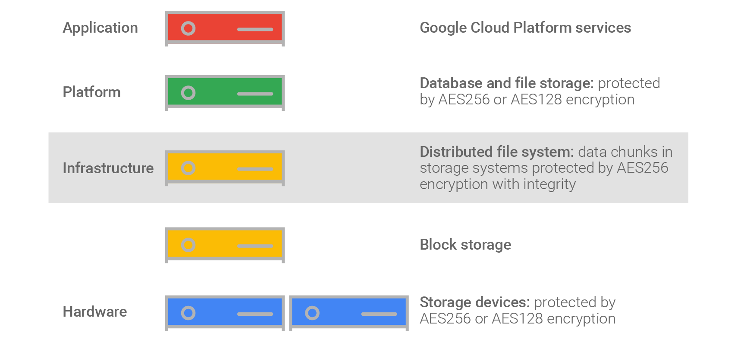
Usages of AES (example : Google Cloud)

Slide 61
Quiz 3
What is the block size of AES?
What are the length of key (Key size) of AES?
How many rounds in AES?
What are the main strengths of AES?

Slide 62
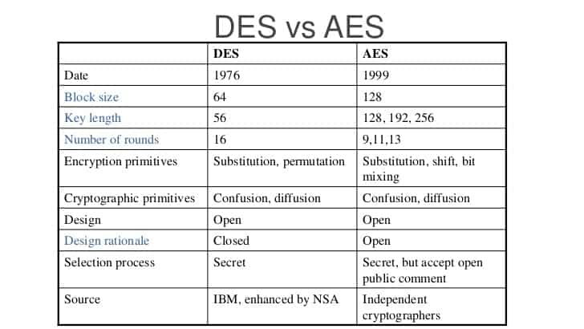
DES vs AES
* Round for AES = 10,12,14 – (includes the final round)

Slide 63
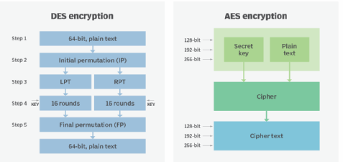
DES vs AES
Feistel Structure
Iterative

Slide 64
Symmetric Encryption Algorithm
07
Key Management

Slide 65
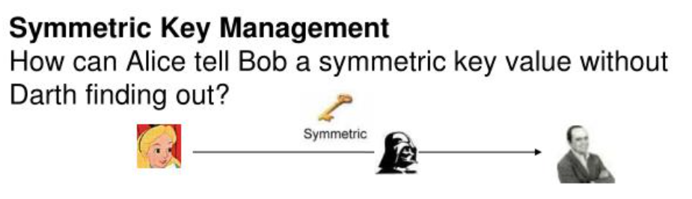
Key Management – Challenge

Slide 66
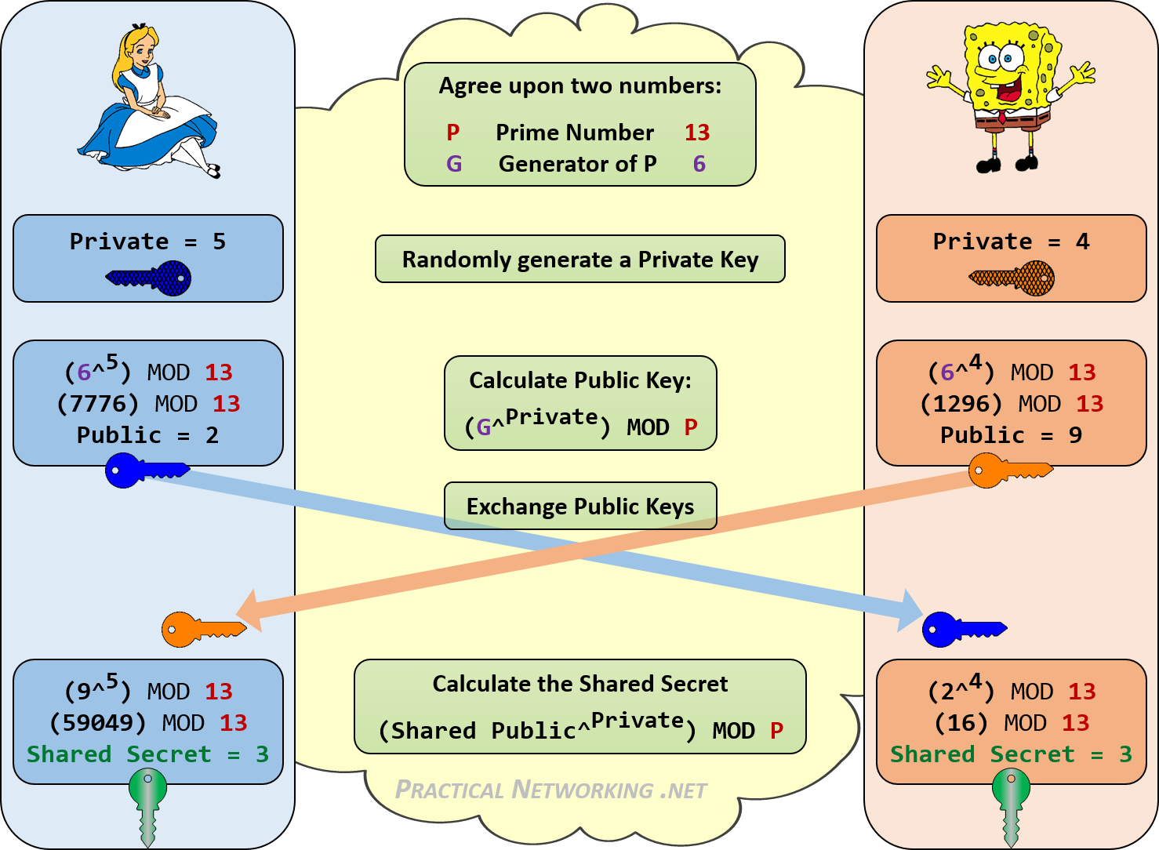
Key Management – Method 1 : Diffie Helman Key Exchange
Process:
Agree on Shared Parameters:
Alice and Bob agree on a large prime number P and a base G.
Generate Private Keys:
Alice generates a private key A
Bob generates a private key B
3. Calculate Public Keys:
Alice calculates her public key AAA
Bob calculates his public key BBB
4. Exchange Public Keys:
Alice sends AAA to Bob.
Bob sends BBB to Alice.
5.Compute Shared Secret:
Alice computes shared secret,SS using BBB
Bob computes shared secret,SS using AAA Both Alice and Bob now have the shared secret, SS which can be used to derive the symmetric key.
Notes:
The Diffie-Hellman exchange ensures that even if Darth intercepts AAA and BBB, he cannot easily determine the shared secret , SS without knowing the private key A or B.

Slide 67
Key Management – Method 2 : Key Distribution Centre (KDC) Kerberos
A Key Distribution Center is the way to automatically distribute keys to support arbitrary connections between pairs of users.
The users can be a computer, a process or applications.
Each user shares a unique key with the KDC, known as the master key.
The master key is used to identify the user and, the second key is used to encrypt the communication between the two users. This second key is usually known as the session key.
The session key is encrypted using the master key and it is then sent to the clients for an end-to-end encrypted connection.
Each session will have a different key. This is an extra layer of protection because all the traffic is encrypted using different keys.
So, if an attacker gets one key, it won’t be able to decrypt all the messages, only those messages encrypted with the specific key.

Slide 68
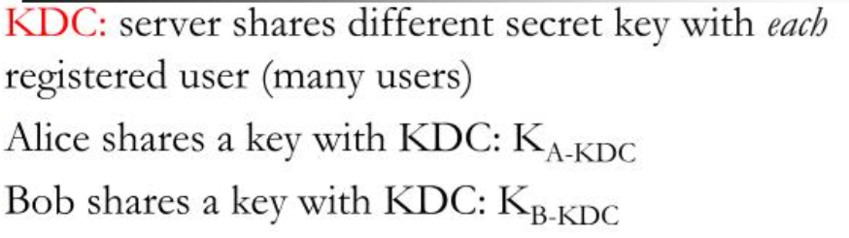
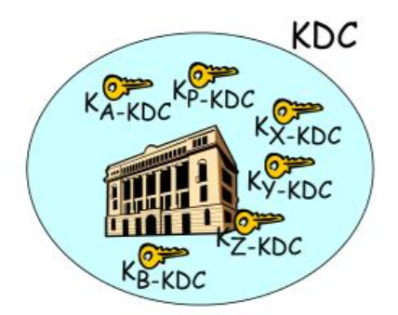
Key Management – Method 2 : Key Distribution Centre (KDC)

Slide 69
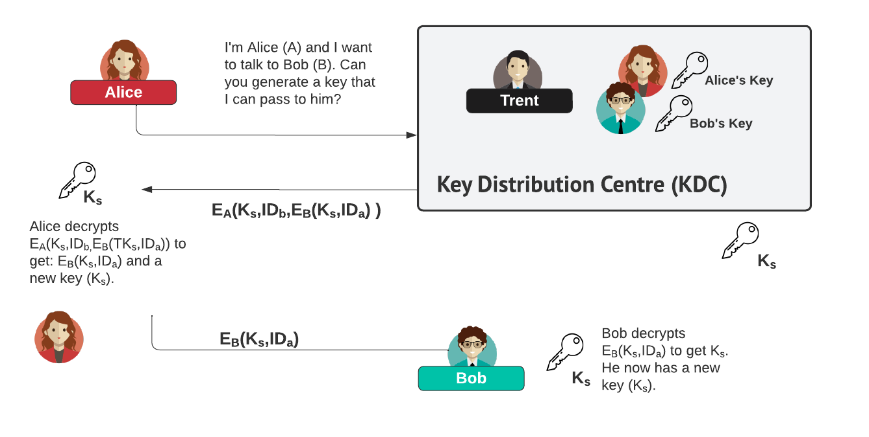
Key Management – Method 2 : Key Distribution Centre (KDC)
Notes:
Alice sends a message to the KDC saying she (A) wants to communicate with Bob (B).
The KDC then authenticates Alice. The KDC then generates a random number, R1. This is the shared key value that Alice and Bob will use to perform symmetric encryption when they communicate with each other. This key is referred to as a one-time session key
The KDC now needs to inform Alice and Bob of the value of Ks. The KDC thus sends back an encrypted message to Alice (containing the following:
Ks, the one-time session key that Alice and Bob will use to communicate;
A pair of values: IDa, and Ks, encrypted by the KDC using Bob's key, K_{B-KDC} .
These items are put into a message and encrypted using Alice's shared key.
Alice receives the message from the KDC, verifies the nonce, extracts Ks from the message and saves it. Alice now knows the one-time session key, Ks.
Alice also extracts (Ks,IDa) and forwards this to Bob.
Bob decrypts the received message, using his key and extracts Ks,IDa. Bob now knows the one-time session key, R1, and the person with whom he is sharing this key, A. Of course, he takes care to authenticate Alice using R1 before proceeding any further.
IDa – Identity of Alice
Ks – Session Key

Slide 70
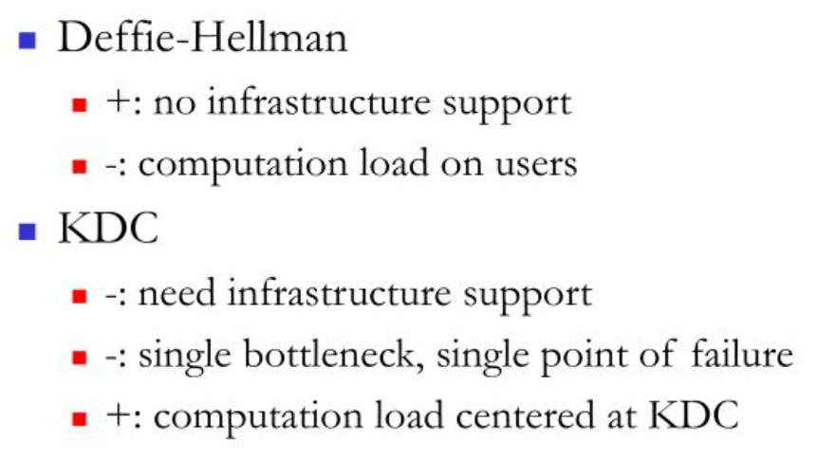
Key Management : Comparison of Methods

Slide 71
Summary
Feistel
Cipher
/ Structure
DES
AES
Block Cipher Mode of Operation
Key Management

Slide 72
Test 1
Mode: Physical
Test Date/Time : TBD
Test Venue : TBD
Duration for Test: 90 Minutes
No of Questions : TBD
Format : MCQ, True/False, Subjective
Topics : 01 until 06 (except 2)

